Slide 1
Monte Carlo TREE SEARCH
Yuval Vizel

Slide 2
outline
Search algorithms
Minimax
Alpha–beta pruning
MCTS
Tic Tac Toe
Search algorithm
Guided random search techniques
MCTS
Example: Go

Slide 3
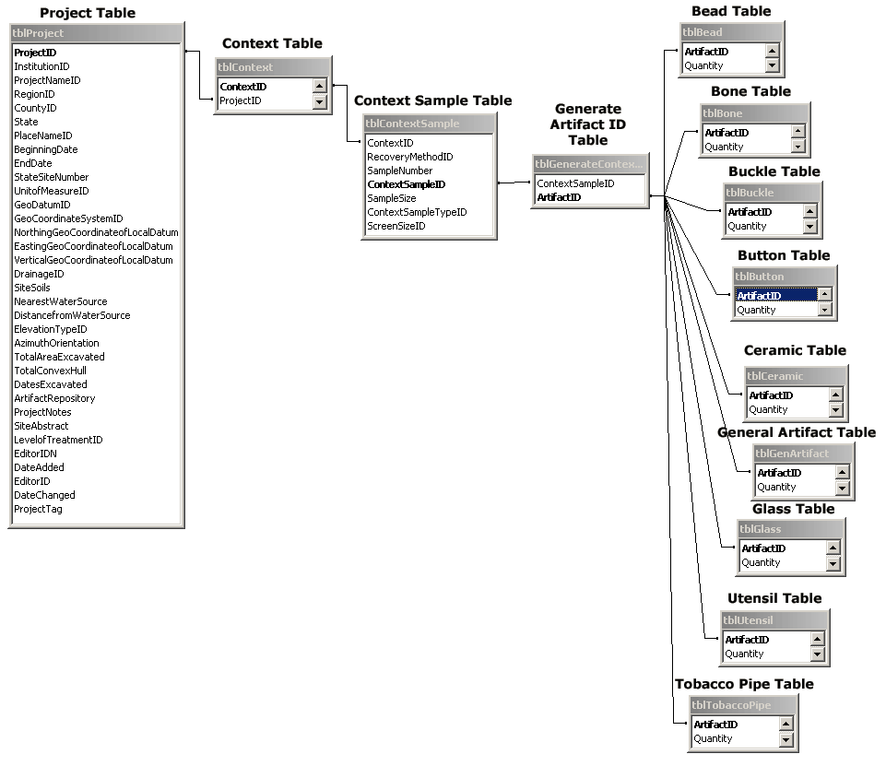
Search algorithm
An algorithm used to search for any given content or information that stored in data structure.
The desired content for the search will be characterized by a certain criterion.
Depending on whether the data is sorted or not.
We will want an efficient algorithm that returns the correct answer as quickly as possible.

Slide 4
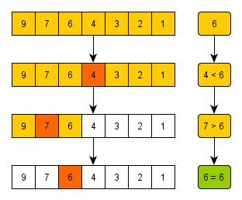
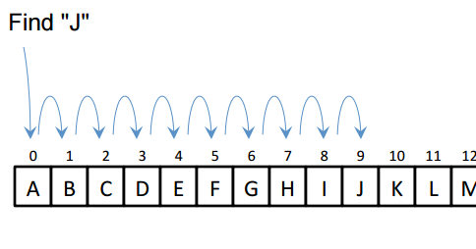
Types of Search algorithm
Linear Search.
Binary Search.
Tree Search.
Genetic Search.
Heuristic Search.
Notes:
Linear Search- הכי פשוט - סורק את כל איברי המערך ומחפש את האיבר הרצוי.
Binary Search - למציאת מקומו של איבר במערך ממוין – בדיקת האיבר האמצעי ואז אם קטן או גדול.
Tree Search – חיפוש על גבי עץ כאשר במידע מאוחסן בעצם בעץ.
Genetic Search - אלגוריתמים לחיפוש, מידול ומיטוב (אופטימיזציה), שבהם משלבים זה בזה אלמנטים של פתרונות אפשריים לבעיה, ומפעילים הליכים של ברירה מלאכותית כדי לבחור את המועמדים שיעברו לשלבים הבאים.
Heurictic Search- היא שיטת חיפוש המתבטאת בהערכה וניחוש המצמצמים את אזור החיפוש של פתרון מסוים לבעיה, ולכן מקצרים את זמן החיפוש מחד גיסא, אך אינם מבטיחים הצלחה מאידך גיסא. בשיטות היוריסטיות מעבר ממצב אחד למצב הבא נקבע על סמך שיקולים היוריסטיים, המציינים את מידת הכדאיות לעבור למצב הבא שנבחר, שממנו ניתן להגיע אל היעד. שיקולים היוריסטיים לא בהכרח מבוססים על חישובים מספריים. את השיקולים ההיוריסטיים ניתן לייצג בעזרת פונקציות היוריסטיות. פונקציה היוריסטית מתאימה לכל מצב ציון המבטא את ערך השיקולים ההיוריסטיים, לפיו עוברים למצב הבא.

Slide 5
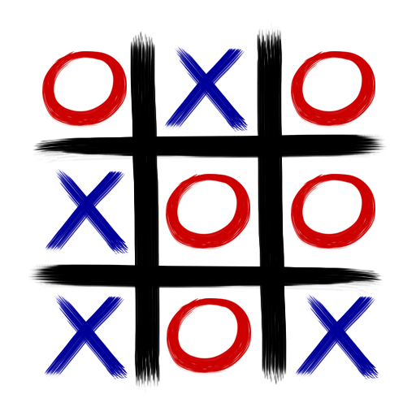
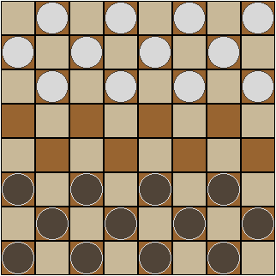
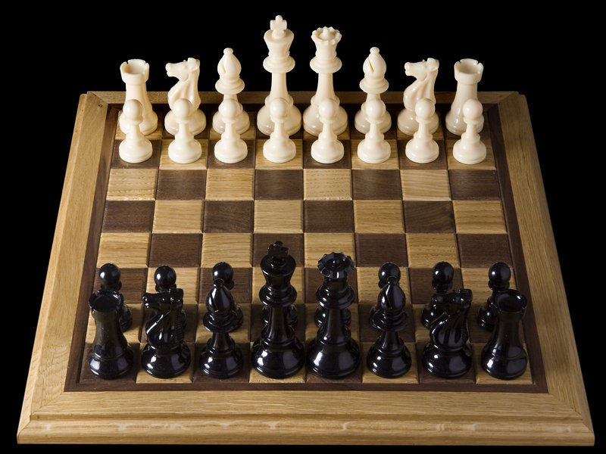
Minimax and alpha beta pruning

Slide 6
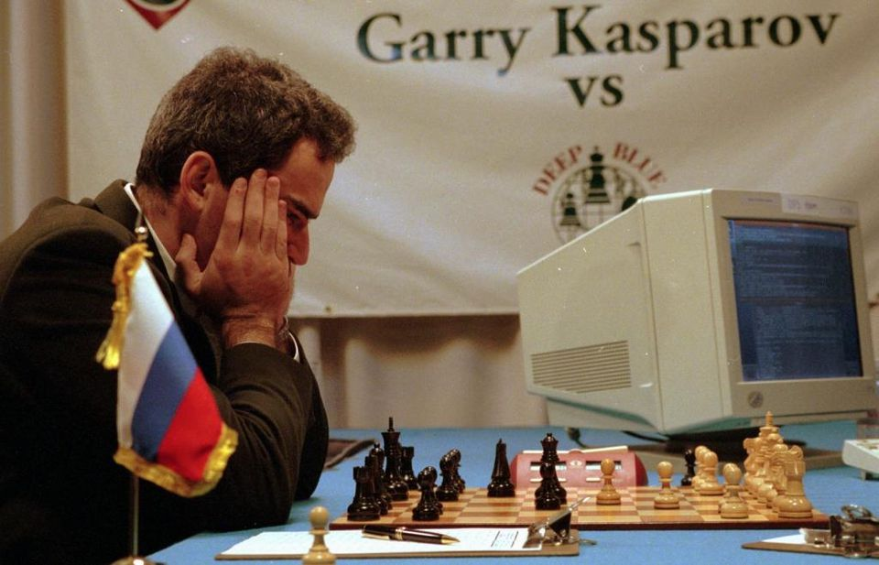
history
1769 – The Turk – automaton chess player.
1957 – was first introduced Alpha beta pruning.
1963 – Hubert Dreyfus claims “Computers can’t play chess”.
1968 – David Levy: “No computer would beat the world champion within 10 years”.
1976- Chess 4.5 won the Class B section of the Paul Masson American Chess Championship.
1980 – Belle was developed by Joe Condon.
1983 – Belle was the first machine to achieve master level play.
1993 – Brugmann – first MC program for go.
1996 – first match between Deep Blue and Gary Kasparov.
1997 – Deep Blue beat Garry Kasparov.
…
2015 – first time a computer go program (AlphaGo) beaten a professional human player on full-sized board.
2017 – AlphaGo beat Ke Jie – the world No. 1 ranked player at the time.
1970

Slide 7
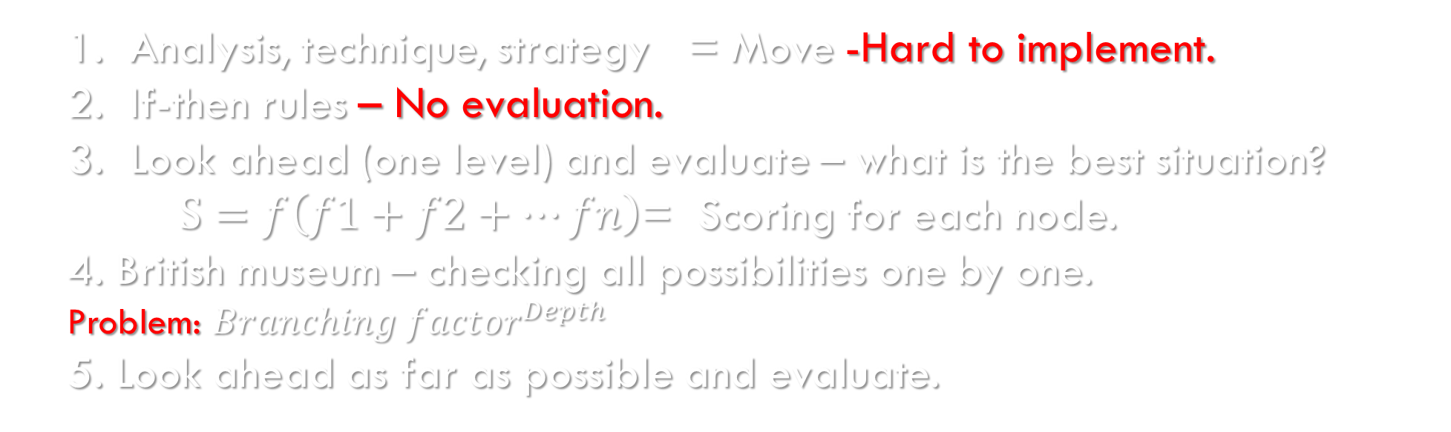
artificial intelligence’s Evolution
Analysis, technique, strategy = Move -Hard to implement.
If-then rules – No evaluation.
Look ahead (one level) and evaluate – what is the best situation?
$S=f\left(f1+f2+…fn\right)$= Scoring for each node.
4. British museum – checking all possibilities one by one.
Problem: ${Branching factor}^{Depth}$
5. Look ahead as far as possible and evaluate.

Slide 8
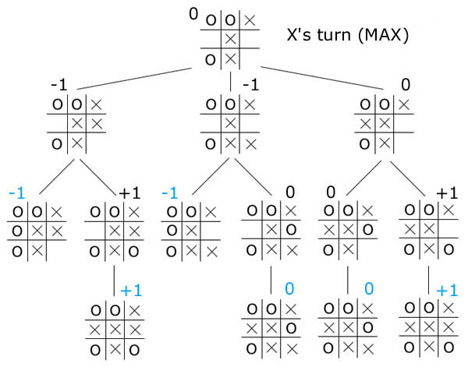
Game tree
A game tree is a Unintended graph.
The root is the initial state.
Nodes are game state.
Each edge represents a legal move.
Leaf nodes represent final game state.
Assumption: theoretically allows the development of
any tree search under assumption that the branching
factor is blocked.

Slide 9

Minimax algorithm
Definition:
A backtracking algorithm, Which given a particular game mode, decides on the optimal step for the player.
It takes into account all the possible moves that
players can take at any given time during the game.
Not relevant for games with a large branching factor.

Slide 10
Minimax’s Properties
Set of games:
Zero-sum game.
Two players.
Played in turns.
Deterministic.
Full game information.

Slide 11
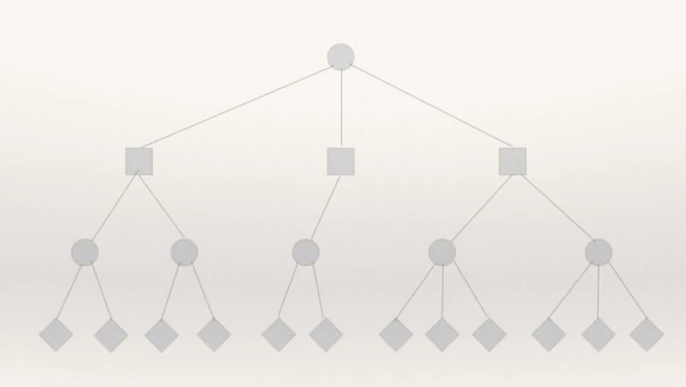
The game Progress
In each turn the player selects the optimal step (max) while his opponent selects the worst step for him(min).

Slide 12
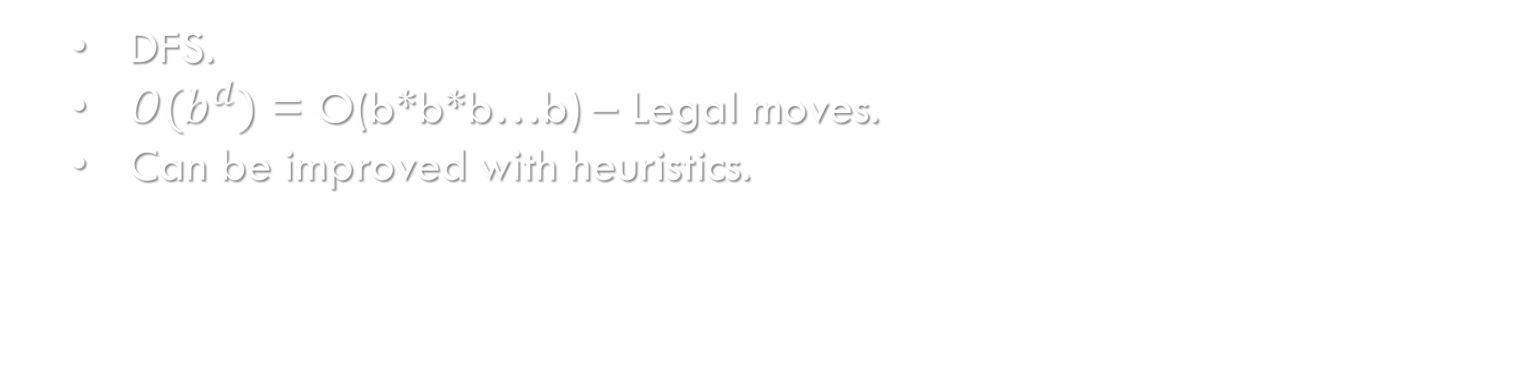
Minimax’s Discussion
Minimax is a type of tree search algorithm.
Each leaf contains a final state (terminal) that has a value associated with it.
Move through the tree from the leaves towards the root.
The assumption is that the opposing player also plays optimally.
DFS.
${O(b}^{d})$ = O(b*b*b…b) – Legal moves.
Can be improved with heuristics.

Slide 13
Alpha beta PRUNING
Alpha Beta is a search algorithm that optimizes the Minimax algorithm.
Reduce the number of moves for each possible move in the Minimax tree.
We'll get the same result we were supposed to get at Minimax algorithm.
The meaning of the optimization: shortening the search time
In the course of searching in depth, partial solutions can be abandoned. once they are clearly worse than solutions we have already seen.
Uses previous information.

Slide 14
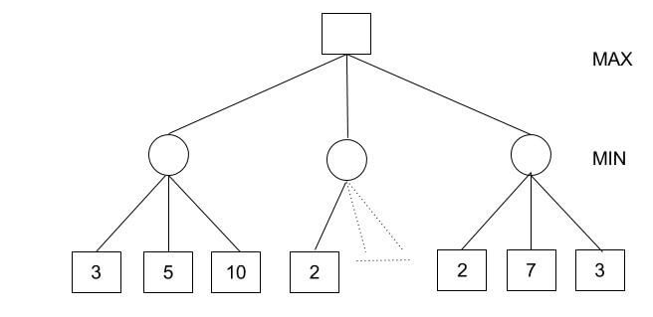
Alpha beta example [1]
How it works?
Minimax Decision = MAX{MIN{3,5,10}, MIN{2,a,b}, MIN{2,7,3}} = MAX{3,c,2} = 3

Slide 15
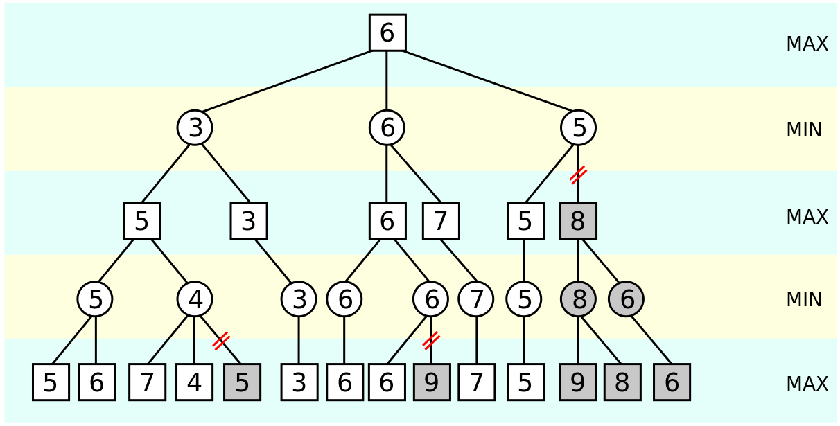
Alpha beta example [2]
≥3
≥6
≤5
≤6
≤5
≥5
≥6
≤5
≤4
≤6
≤7

Slide 16
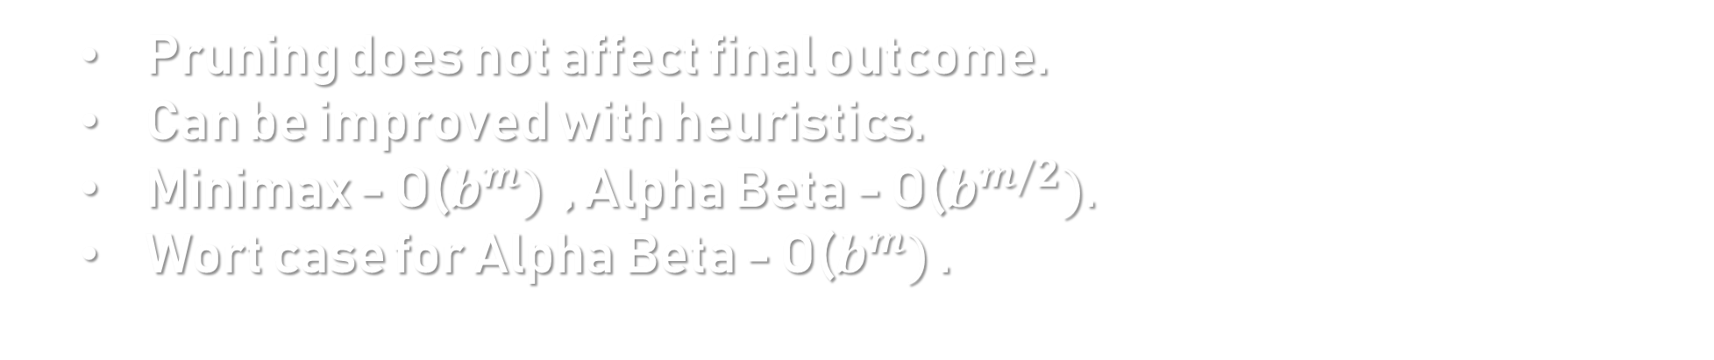
Alpha beta Discussion
Pruning does not affect final outcome.
Can be improved with heuristics.
Minimax - O($b^{m})$ , Alpha Beta - O($b^{m/2}).$
Wort case for Alpha Beta - O($b^{m})$ .

Slide 17

Monte carlo algorithm

Slide 18
Monte carlo
Also called ‘Monte Carlo Method’
Random algorithm for solving computational problems with random numbers.
A method for estimating a value using principles on inferential statistics.
inferential statistics: Population , Sample & Key fact.
Sample a small set of examples.
Random sample to exhibit the same properties as the population.
Set of examples.
Notes:
פיתרון מקורב כמו אנליזה נומרית במתמטיקה.

Slide 19
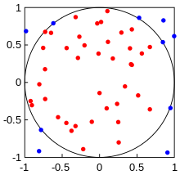
The basic structure
Define statistical properties of possible inputs.
Generate many possible random sets of possible inputs.
Perform deterministic calculations with these sets of inputs.
Analyze results statistically.

Slide 20
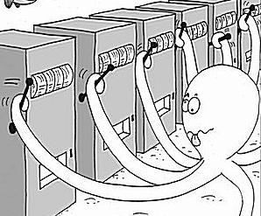
Multi-Armed-Bandit example
Also known as “One-armed bandit” or “Slot Machine”.
Problem description:
Slot machine has several handles with different probabilities of success.
We don’t know what is the handle with highest probability of achieving the greatest profit.
The main question: What is the most profitable handle?

Slide 21
Multi-Armed-Bandit
Objective: to know which action will gave us the highest reward.
By simulations we can sample rewards of actions.
The simulation is actually pulling slot machine arm with random payoff function.
strategy:
Create balance between two preferences:
Preference in choosing the handle with the highest profit average.
Preference for the ones we tried less often.

Slide 22
Multi-Armed-Bandit
To know which handle has the highest average we will have to run it multiple times.
We need also run the handle we ran at least few times to get a confidence level that we really found the optimal result possible.
Also, we must run all the handles to prevent cases of 'bad luck' in the correct handle.
The UCB formula balances the exploitation of known rewards with the exploration of relatively unvisited nodes.

Slide 23

Ucb - upper confidence bounds
Constant - is a tunable bias parameter.
is the total number of times that
its parent has been visited.
the estimated value of the node.
the number of the times the node has been visited.

Slide 24
Monte carlo’s uses
Error estimation.
Numerical integration.
Numerical simulations.
Optimization.
AI.
And more…

Slide 25
Monte carlo tree search
Definition:
A method for making optimal decisions in artificial intelligence problems.
It is a best-first search.
The leaf node evaluate by monte carlo method.
Effective for use in cases where the branching factor vary high.

Slide 26
How?
How MCTS can “plan” ahead?
MCTS builds a statistics tree that partially maps onto the entire game tree.
The statistics tree gives an information to the AI for what “look mostly/ mostly at the most interesting parts of the game tree”.
Values of nodes determined by simulations (estimate the true value).
We continue to run iterations of Monte Carlo tree search until we run out of time.

Slide 27
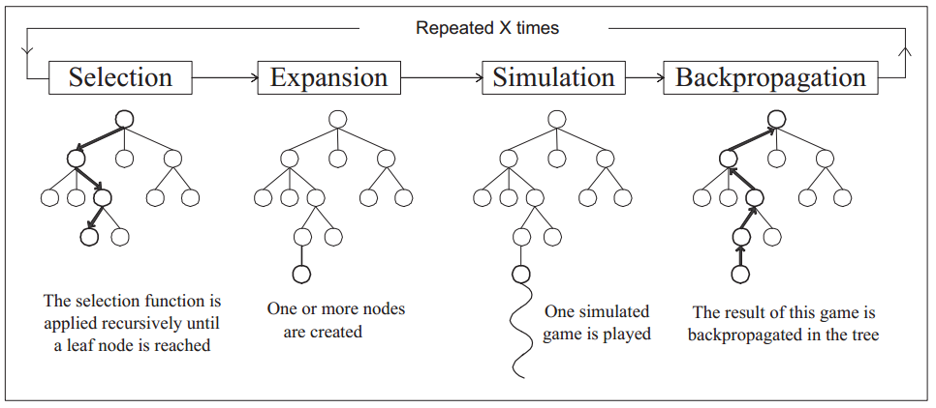
Structure of the algorithm:

Slide 28
Mcts pseudo-code
start
ROLLOUT
ROLLOUT (Si) :
loop forever:
if Si is a terminal state:
retrun value (Si)
Ai = random_MC(available_actions (Si))
Si = simulation(Ai , Si )
Current =S0
Backpropagation to the root
Yes, never been sampled
Is current leaf node?
Is the ni value for current is zero?
yes
no
No, Expansion
Current=child node of current that maximizes (higher score) UCT(Si)
For each available action from current, add a new state to the tree
Current= first new child node
ROLLOUT

Slide 29
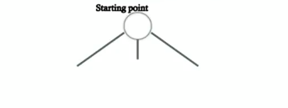
Mcts demonstration
Bulid the tree from the starting state.

Slide 30
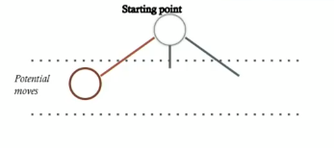
Mcts demonstration
Expansion:
Add a new node to the state tree.

Slide 31
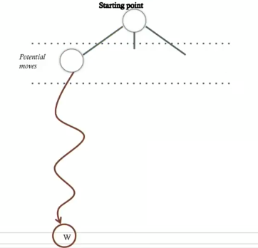
Mcts demonstration
Simulation – random play:
Make random moves repeatedly until the game is won, or lost.
In a normal tree search we use evaluation function, in MCTS we use
simulation.

Slide 32
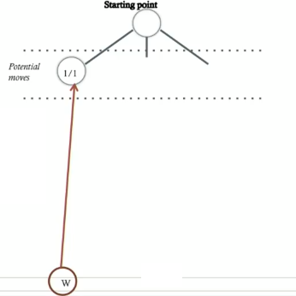
Mcts demonstration
Update (backpropagation):
Depending on win or loss , update the child node and all the way up.

Slide 33
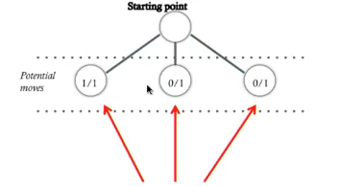
Mcts demonstration
Update:
The left child node is the better move for now.
More simulations will make them more accurate.

Slide 34
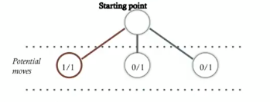
Mcts demonstration
Selection:
How good are the states ?
How much has child node been “ignored” ?
All child nodes have been visited at lest once.
The AI select which node to be investigated further.

Slide 35
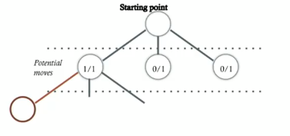
Mcts demonstration
Expansion:
Expanse the tree from the selected state.

Slide 36
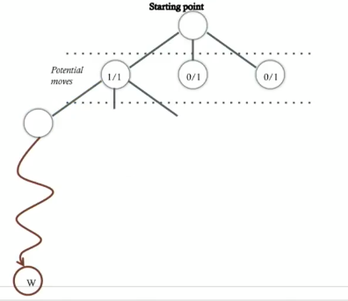
Mcts demonstration
Simulation:

Slide 37
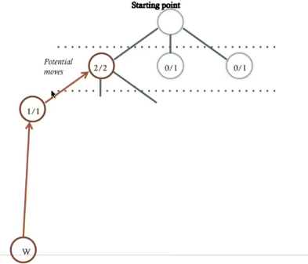
Mcts demonstration
Update (backpropagation):

Slide 38
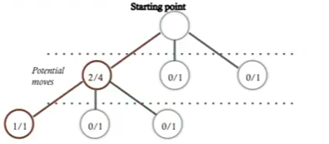
Mcts demonstration
Selection:

Slide 39
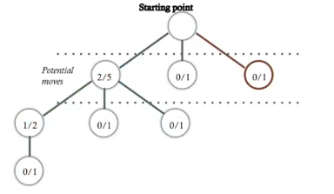
Mcts demonstration
Selection:

Slide 40
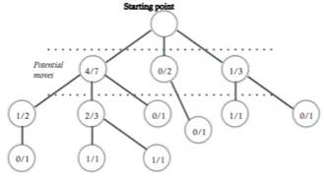
Mcts demonstration
Time is up:

Slide 41
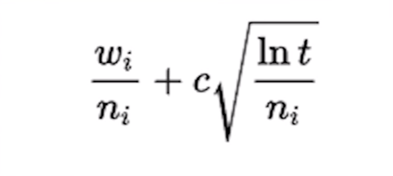
UCT (selection level)
Upper confidence bound applied to trees – in tree search we want that in a given sufficient time , all nodes will receive their optimal value.
The UCT choose which node to visit next based on the formula:
Average value of the state.
wi = number of wins after the i-th move
ni= number of simulations (visits) after the i-th move
c= exploration parameter - constant
t= total number of simulations for the parent node

Slide 42
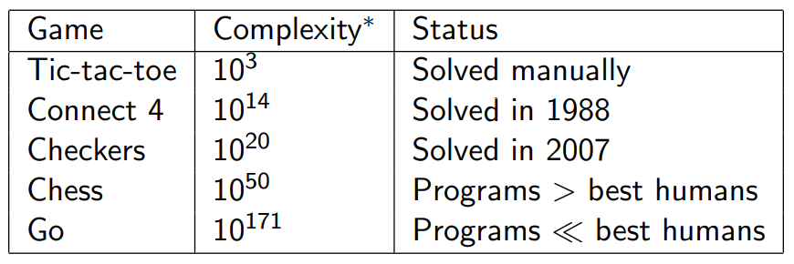
Tic tac toe
Important to note: MCTS usually for games with high branching factors (go , hex , video games) because unlike minimax which needs a full game tree to a certain depth.
MCTS can be configured to stop after a desired amount of time and can select a sufficiently optimal solution based on the partially constructed game tree.
255,168 ways of playing Tic Tac Toe.
Has only 5478 states.

Slide 43
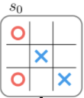
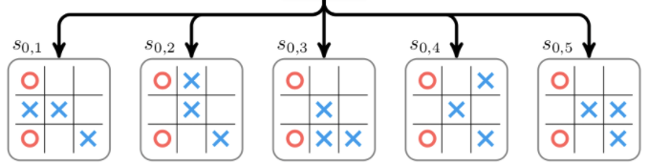
Tic tac toe demonstration
S0 = initial state.
A = set of actions.
Selection

Slide 44
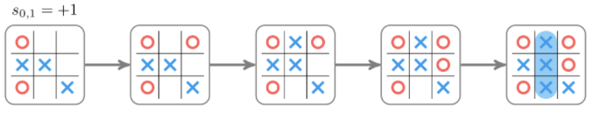
Tic tac toe demonstration
Simulation:

Slide 45
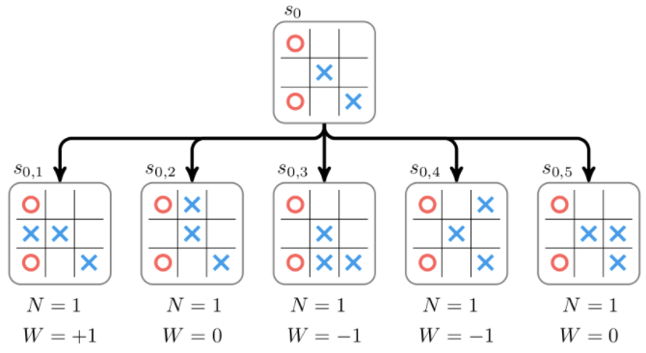
Tic tac toe demonstration
Wins: +1
losses : -1
ties: 0
N : number of visits
W : the accumulated value.
Update:

Slide 46
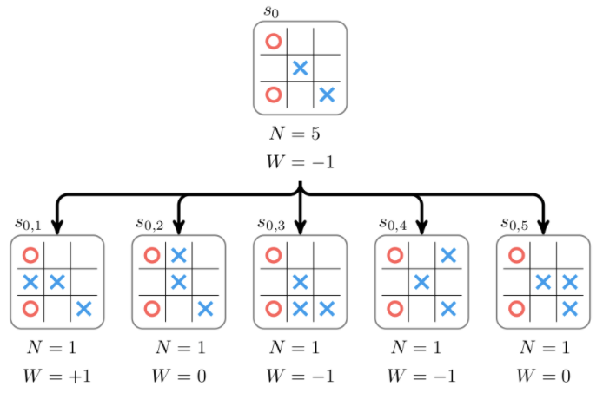
Tic tac toe demonstration
backpropagation :

Slide 47
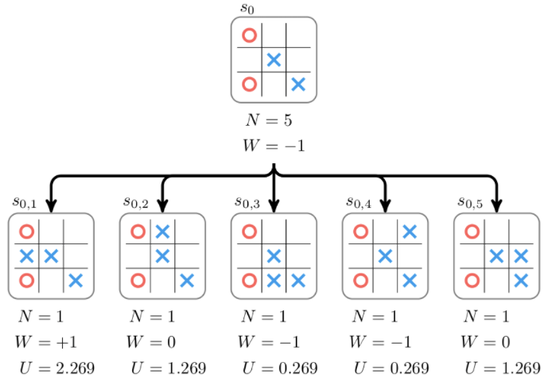
Tic tac toe demonstration
Expansion :

Slide 48
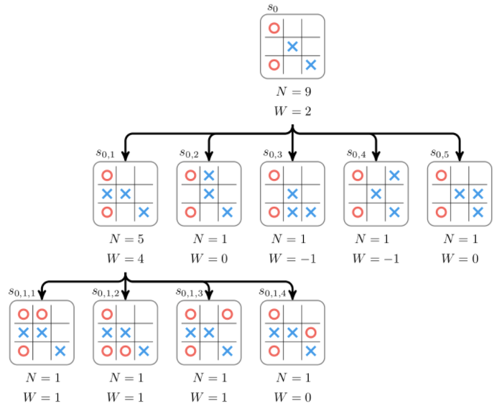
Tic tac toe demonstration
Expansion :

Slide 49
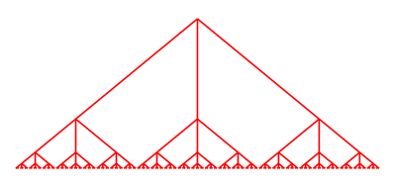
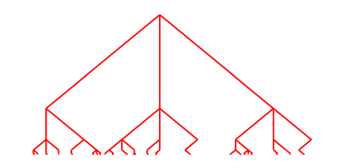
conclusion
MCTS is more effective for game with a high branching factor.
However , Minimax and Alpha Beta are more effective for games with a lower branching factor.
MCTS is a major algorithm in artificial intelligence development.
MINIMAX ALPHA BETA MCTS

